Slide 1
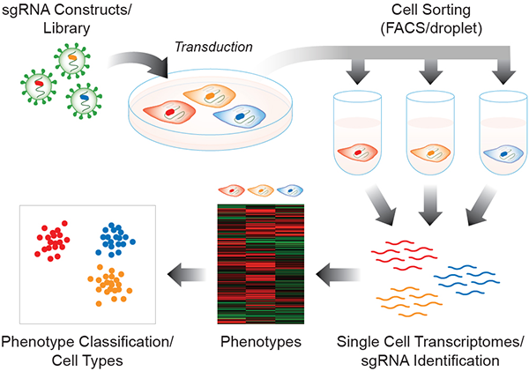
What is perturb-seq?
Also known as CRISP-seq or CROP-seq
High throughput single cell RNA sequencing on perturbation pools
Gene perturbation → Phenotype expression
Notes:
Perturb-seq (aka CRISP-seq or CROP-seq) is a high throughput method that consists on performing a single cell RNA sequencing on pooled genetic perturbation screens. This way of sequencing allows us to assess gene expression phenotypes for each perturbation. Applying perturbations to knock down or out genes and studying the resulting phenotype is also called reverse genetics.

